Slide 1

Big Data Technologies And Why They Matter To R Users
Bob Wakefield
Principal
bob@MassStreet.net
Twitter: @BobLovesData

Slide 2

No Deep Dives Today It’s all 10,000 ft and the speed of heat

Slide 3
Motivation For Today’s Presentation
If I have more data can’t I just get a bigger machine?
How does Spark relate to Hadoop?

Slide 4
Today’s Take Away
The way you access data in the future is going to radically change. Be aware and ready.

Slide 5
Intended Audience
People getting started in data
Academics that work with data
(If you’re already working in industry, you might be bored.)

Slide 6
What exactly have you been studying for the past four years?!

Slide 7
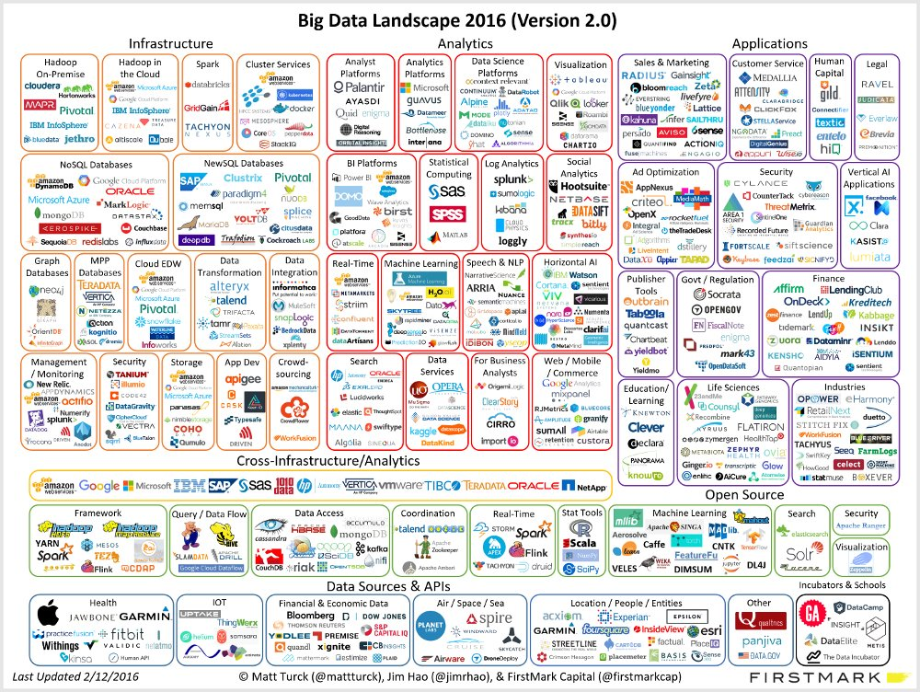

Slide 8
We’re Experiencing A Modern Tech Renaissance
Hadoop -> SQL On Hadoop -> NoSQL ->
In Memory Databases ->MPP -> Spark 1.0 ->
Spark 2.0 -> Deep Learning -> Blockchain

Slide 9
Podcast Plug
Not So Standard Deviations
Roger Peng, PhD Biostatistician Johns Hopkins School Of Public Health
Hillary Parker, PhD Data Scientist Stitch Fix

Slide 10
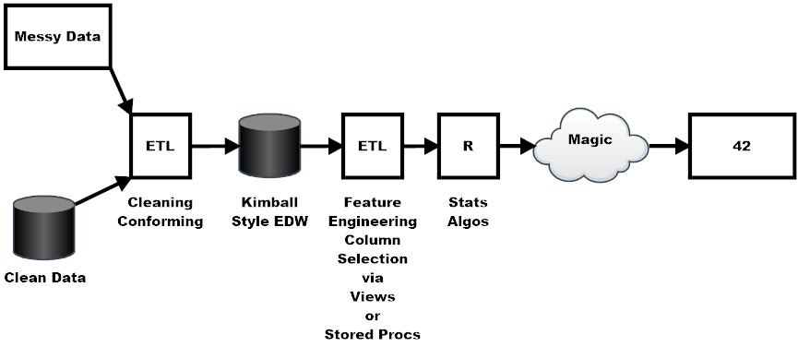
My Workflow

Slide 11
Data Retrieval And Storage
What is Hadoop?
Can mean a lot of things depending on context.
Could mean Hadoop core.
Could mean the entire set of Big Data tools.
Could mean the MapReduce framework.

Slide 12
Data Retrieval And Storage
What is Hadoop?
Provides distributed fault tolerant data storage
Provides linear scalability on commodity hardware
Translation: Take all of your data, throw it across a bunch of cheap machines, and analyze it. Get more data? Add more machines

Slide 13
Data Retrieval And Storage
Cloud Storage
AWS
S3 is the gold standard
MS Azure
Google Cloud

Slide 14
Cloud Solutions Bob’s Thoughts
Great for tactical solutions.
If you’re a smaller organization, cloud offers a managed solution.
Can be a hassle. You need top flight network engineers.
Moving to the cloud is not something to do lightly. It requires long term thinking.
I have no idea why anybody waste time with on prim servers anymore.

Slide 15

Data Retrieval And Storage
What Is Hive?
Hadoop warehouse solution
SQLesque language called Hive Query Language
Adds structure to unstructured data
Provides a window into HDFS
You can connect through ODBC/JDBC
Which means you can work with Hive using standard BI tools

Slide 16
Data Retrieval And Storage
NoSQL Databases
Key Value – A simple hash table, primarily used when all access to the database is via primary key.
Document – The database stores and retrieves documents, which can be XML, JSON, BSON
Column-family - Data is stored in columns
Graph – allows you to store relationships between entities

Slide 17
Data Retrieval And Storage
Issues with NoSQL Databases
They do NOT work like relational databases
The guarantees that you are used to aren’t there
CAP theory (consistency, availability, partition tolerance)
Each database has it’s own query language
That language will frequently look NOTHING like SQL

Slide 18
Data Retrieval And Storage
Examples of NoSQL Databases
Document | Key Value | Column Store | Graph
Mongo DB | Apache Accumulo | Apache Accumulo | Neo4J
 | Redis (in memory) | Druid
 |  | Cassandra (DataStax)
 |  | Hbase

Slide 19
Data Retrieval And Storage
New SQL Databases
Distributed versions of databases you’re used to
New concept Hybrid Transactional/Analytical Processing (HTAP)

Slide 20
Data Retrieval And Storage
New SQL Databases
In Memory Databases
MemSQL
VoltDB
NuoDB

Slide 21
Data Retrieval And Storage
MPP Databases
More suited to analytics
Examples
Greenplumb
SQL Server PDW
MySQL Cluster CGE

Slide 22
Real Time Processing
Apache Spark Structured Streaming - scalable and fault-tolerant stream processing engine built on the Spark SQL engine.
Apache Storm – Storm is a distributed real-time computation system for processing fast, large streams of data adding reliable real-time data processing capabilities to Apache Hadoop 2.x.
Apache Flume – Flume allows you to efficiently aggregate and move large amounts of log data from many different sources to Hadoop.

Slide 23
Real Time Processing
Other real time processing frameworks
Apache Flink
Apache Samza
They all have benefits and drawbacks

Slide 24
What Is Spark
Distributed in memory processing framework
Rapidly replacing MapReduce as a means to crunch data.
Many ways to interact with Spark
R, Java, Scala, Python
Sparkr, Sparklyr, H2O with Sparkling Water
Several APIs
RDDs, Dataset/Dataframe, Spark Streaming, Spark SQL, Spark Streaming, Strucutred Streaming

Slide 25
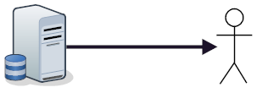
How You Work Now

Slide 26
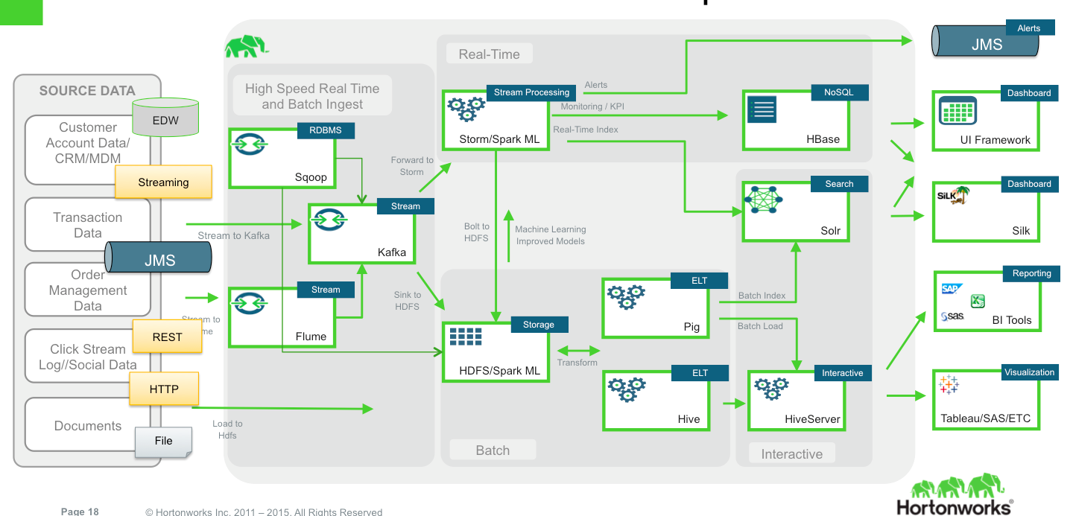
What You Might Have To Deal With

Slide 27
Q&A

